Slide 1


Combinação de classificadores homogêneos
(Homogeneous ensembles classifiers)
Aprendizagem de máquina
João Luiz e Vandeyberg

Slide 2
Agenda
Introduction
Homogeneous ensembles methods
Application
Conclusions
References

Slide 3
Introduction

Slide 4
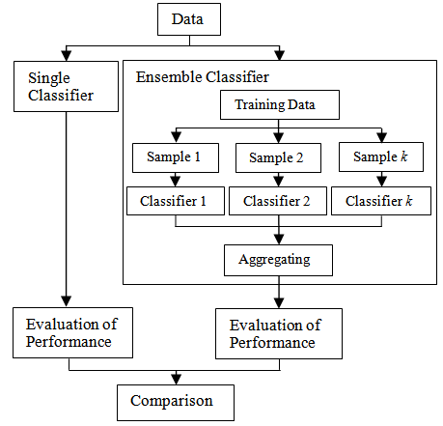
Single classifier vs Ensemble classifier
Trade-off
Computer cost
Interpretation
Precision

Slide 5
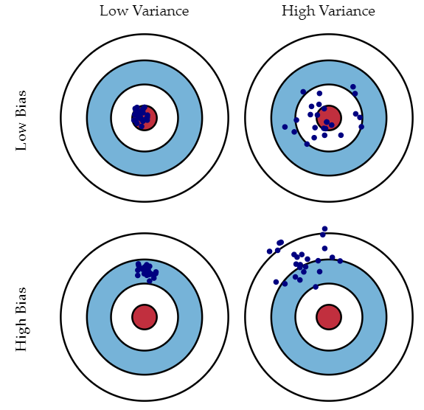
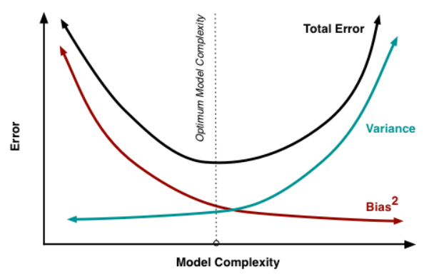
Bias and Variance

Slide 6
Stable and Unstable Classifiers
Stable classifiers
Low variance and High bias
Ex: Linear regression and Naive Bayes
Unstable classifiers
Low bias and High variance
Ex: Decision Trees and NN

Slide 7
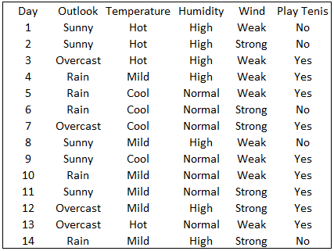
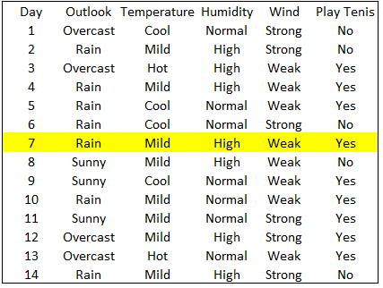
Stable and Unstable Classifiers

Slide 8
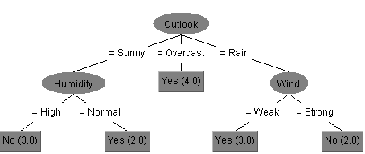
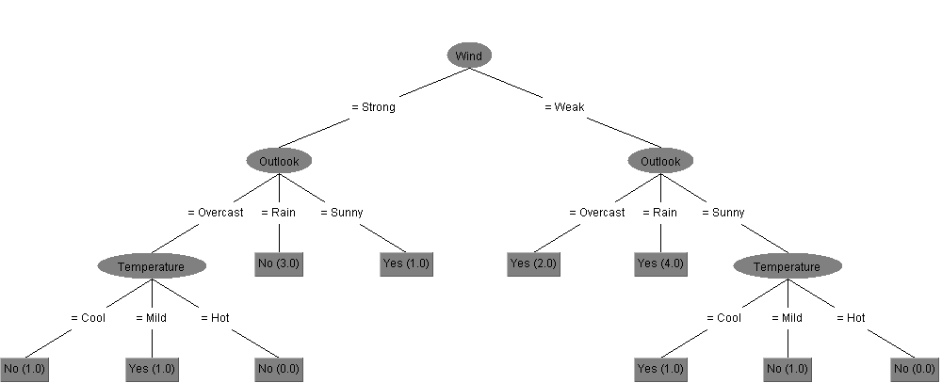
Stable and Unstable Classifiers

Slide 9
2. Homogeneous ensembles methods

Slide 10
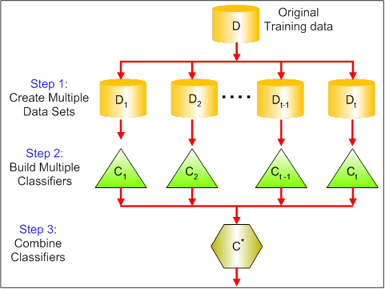
Bagging
1. Create n new random samples (sampling with replacement)
n = 10 is generally enough (Breiman, 1996)
2. Apply the same algorithm to all samples
3. Aggregating Classifiers
mean, median or mode

Slide 11
Boosting
1. Associate weights for each object
2. Generate a new classifier
3. Adjust the weights* according to objects performances
4. Repeat steps 1, 2 and 3
5. Conjugate classifiers by voting its weights**
* objects weight
** classifiers weight

Slide 12
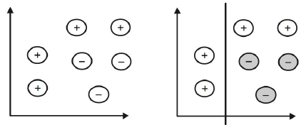
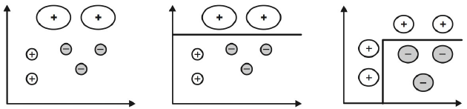
Boosting
1
2
3
4
5

Slide 13
Other methods of ensemble
Methods based on:
Manipulating the Input Features
Injecting randomness
Manipulating the Output Targets

Slide 14
3. Application

Slide 15
Aplicação
data overview
pre-processing
method/code
results analysis

Slide 16
4. Conclusions

Slide 17
References

